Slide 1

Online Encounter 16
Notes:
ENCOUNTER 16
REVIEW STUDENT PROGRESS
Check for last Encounter attendance.
Check for last Speaking Center attendance and time spent.
Check that Lesson 3 has been completed.
Prepare general comments on Student attendance, study habits, and overall progress.
VIDEO SUMMARY
Shen collides with Marti Blum outside his building. They both drop their things everywhere and have to spend time sorting out what belongs to whom. Marti sees the script Shen is reading and introduces herself. Shen is excited to discover she runs a talent agency, but unfortunately he drops her business card as she walks away.
Mrs. Berry interrupts her martial arts practice to go to see Sofi, who is sick and cannot go to work. Sofi and Mrs. Berry talk about Sofi’s symptoms.
At The Company Company, a computer virus puts the whole office out of action. Todd demands they work on their laptops or phones. Khae and Marco are so impressed with Aanya’s super-slim laptop that they both decide to order new laptops for themselves online.
VOCABULARY OBJECTIVES
Can name very basic parts of the body (back; head; leg; nose)
Can name some very common ailments (flu; headache; hurt; ill)
GRAMMAR OBJECTIVES
Can use object pronouns in simple phrases and sentences (Can you call her?)
Can use the possessive pronouns mine and yours with the verb be (They’re yours.)
SPEAKING OBJECTIVE
Can use brief everyday expressions to describe wants and needs, and request information (I don’t need an agent, but I want an agent.)

Slide 2

Encounter 16
Introductions
Your Teacher
My name is .
Now please introduce yourself.
Notes:
INSTRUCTIONS
This is a warm-up activity and should not be assessed.
Introduce yourself to the Students. Then ask each individual Student what his/her name is. Tell the Students:
Hello. My name’s _______. What’s your name?
Sample Responses: My name’s _______./My name is _______.

Slide 3
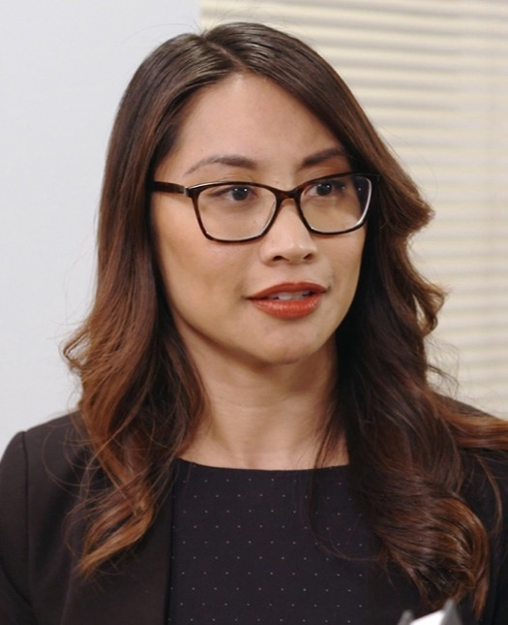
Part 1.0: Warm-Up
Khae is from India. True or false?
Khae speaks Hindi. True or false?
.
False. She speaks English and Thai
.
False. She’s from Thailand
Notes:
1.1 True or False? (5 min)
Allow one minute for this slide.
OBJECTIVE
To help the Students relax and start thinking in English
INSTRUCTIONS
#1. Have a Student read the statement and question. [Khae is from India. True or false?]
#2. Encourage a Student to answer.
#3. Reveal the answer. [False. She’s from Thailand.]
Ask the Students, “What about you? Are you from India?”
Encourage the Students to respond.
#4. Have a Student read the next statement and question. [Khae speaks Hindi. True or false?]
#5. Encourage a Student to answer.
#6. Reveal the answer. [False. She speaks English and Thai.]
Ask the Students, “What about you? Do you speak Hindi?”
Encourage the Students to respond.

Slide 4
Part 1.0: Warm-Up
. True or false?
.
Notes:
1.1 True or False?
Allow four minutes for this slide.
INSTRUCTIONS
Tell the Students to think of true/false sentences for the other Students to respond to. The sentence can be about him/her or about a person in the online story.
TEACHING TIP
If necessary, brainstorm with the Students to come up with sentences. For example,
You eat breakfast every day.
You get to work by subway.
You are 32 years old.
You are a Student.

Slide 5
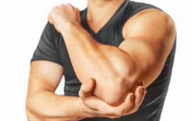
Part 2.0: Target Language
Activity 2.1: Context Creation
.
It’s an arm
What’s this?
Notes:
2.1 Body Parts (5 min)
Allow one minute for this slide.
OBJECTIVE
Can name very basic parts of the body (back; head; leg; nose)
INSTRUCTIONS
#1. Have a Student read the question about the highlighted body part. [What’s this?]
#2. Encourage the Students to answer.
#3. Reveal the answer. [It’s an arm.]
TEACHING TIPS
Elicit a variety of the target vocabulary.
Elicit from each Student.
It helps to board elicited language.

Slide 6

It’s a foot
Part 2.0: Target Language
Activity 2.1: Concept Check
.
It’s a foot
What’s this?
Notes:
2.1 Body Parts
Allow one minute for this slide.
INSTRUCTIONS
#1. Have a Student read the question about the highlighted body part. [What’s this?]
#2. Encourage the Students to answer.
#3. Reveal the answer. [It’s a foot.]
TEACHING TIP
Elicit target language from each Student.

Slide 7
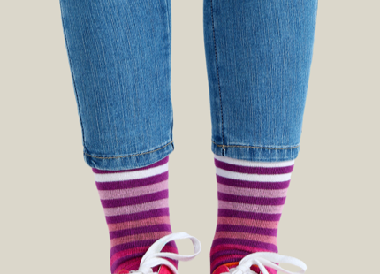

Part 2.0: Target Language
Activity 2.1: Practice
?
.
Notes:
2.1 Body Parts
Allow one minute for this slide.
INSTRUCTIONS
Have a Student ask “What’s this?” about the highlighted part of each image.
Encourage a Student to answer.
TEACHING TIPS
Insist on full sentence answers.
Encourage the Students to help each other if necessary and appropriate.
Review any words that the Students did not know at the end of the activity.
ANSWER KEY
Leg(s)
Eye(s)

Slide 8
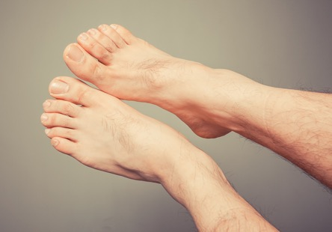
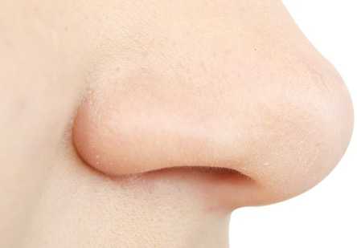
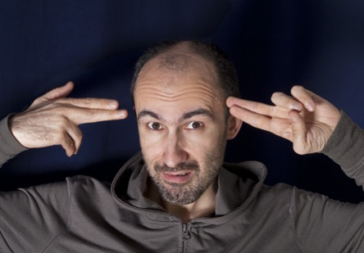
Part 2.0: Target Language
Activity 2.1: Practice
?
.
Notes:
2.1 Body Parts
Allow one minute for this slide.
INSTRUCTIONS
Have a Student ask “What’s this?” about the highlighted part of each image.
Encourage a Student to answer.
ANSWER KEY
Foot
Nose
Head

Slide 9


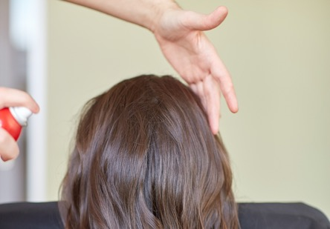
Part 2.0: Target Language
Activity 2.1: Practice
?
.
Notes:
2.1 Body Parts
Allow one minute for this slide.
INSTRUCTIONS
Have a Student ask “What’s this?” about the highlighted part of the image.
Encourage a Student to answer.
ANSWER KEY
Back
Hand
Hair

Slide 10

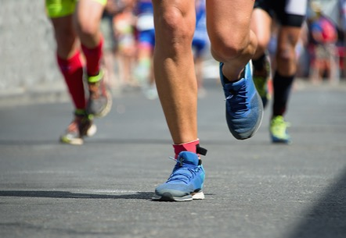
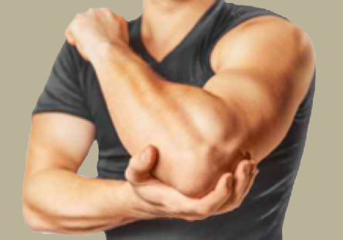
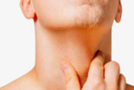

Part 2.0: Target Language
Activity 2.1: Extension Activity
Body parts
Notes:
2.1 Body Parts
Optional Extension
INSTRUCTIONS
Have the Students identify each body part.
Direct the Students’ attention to the first image. [toes]
#2. Reveal the image. [fingers]
#3. Reveal the image. [knee]
#4. Reveal the image. [elbow]
#5. Reveal the image. [neck]
#6. Reveal the image. [eyebrow]
ANSWER KEY
1. toes
2. fingers
3. knee
4. elbow
5. neck
6. eyebrow
TEACHING TIP
If the Students know the words challenge them by asking for more specific body parts.

Slide 11
Part 2.0: Target Language
Activity 2.1: Feedback
Student 1
Student 2
Student 3
Student 4
Great job!
Great job!
Great job!
Great job!
Well done
Well done
Well done
Well done
Good try
Good try
Good try
Good try
More practice
More practice
More practice
More practice
Feedback
Notes:
2.1 Body Parts
FEEDBACK
Quickly give the Students feedback on the target language they just practiced.
Remind them of other resources they can take advantage of to improve their English:
Go to Wall Street World to practice grammar and vocabulary.
Review the Student Manual or Digital Book to study grammar and vocabulary.
Attend Complementary Classes to practice using grammar and vocabulary.
Join Social Clubs to practice speaking skills.

Slide 12
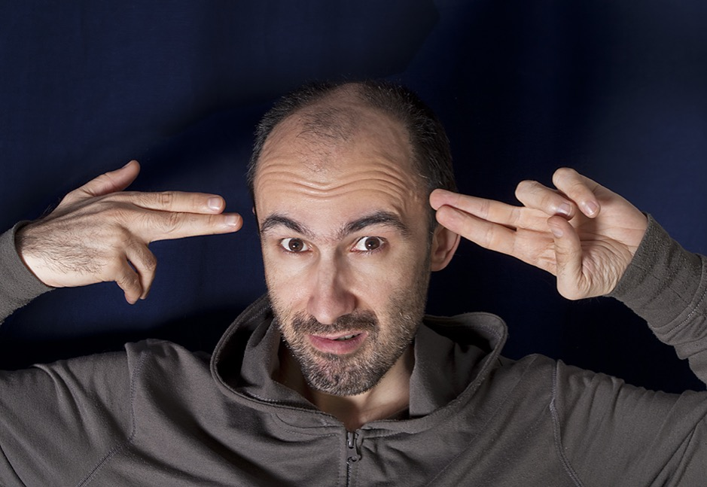
Part 2.0: Target Language
Activity 2.2: Context Creation
This man is ill. What does he have?
.
He has a headache
Notes:
2.2 I Feel Sick (10 min)
Allow one minute for this slide.
OBJECTIVE
Can name some very common ailments (flu; headache; hurt; ill)
INSTRUCTIONS
#1. Have a Student read the statement and question. [This man is ill. What does he have?]
#2. Encourage the Students to answer.
#3. Reveal the answer. [He has a headache.]
TEACHING TIPS
Elicit a variety of the target vocabulary.
Elicit from each Student.
It helps to board elicited language.

Slide 13
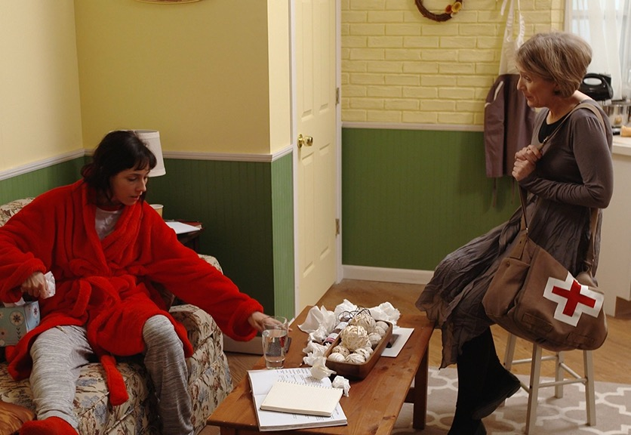
Part 2.0: Target Language
Activity 2.2: Concept Check
What’s wrong with Sofi?
.
Notes:
2.2 I Feel Sick
Allow one minute for this slide.
INSTRUCTIONS
#1. Have a Student read the question. [What’s wrong with Sofi?]
#2. Elicit as many answers as you can by asking each Student to make one sentence. Possible answers include,
She has a cold.
She is tired.
She feels hot and cold.
She has a headache.
She is sick.
She is ill.
TEACHING TIP
Elicit target language from each Student.

Slide 14
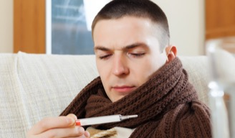

Part 2.0: Target Language
Activity 2.2: Practice
Student A
Student B
You are ill. Call your manager and tell him/her what’s wrong. Use the words below.
Useful phrases and words
I have I feel
I am hurts
hot cold
Your partner is ill and can’t come to work today. Ask him/her what’s wrong. Use the words below.
Useful phrases
What’s wrong? Do you have ?
Do you feel ? I think you have
Notes:
2.2 I Feel Sick
Allow four minutes for this slide.
INSTRUCTIONS
Put the Students into A/B and C/D pairs. Go over the directions for each role.
Allow time for the A/B pair of Students to read the information on the screen and prepare for the role play, simulating a phone call.
Have the Students carry out the role-play. For example,
A: Hello, boss?
B: Hello, how are you?
A: I am sick.
B: OK, what’s wrong?
A: I feel hot and cold and I feel sick.
B: I think you have a cold. Stay at home and lie down.
TEACHING TIPS
If there is time, have the Students switch roles.
If you have a stronger group, switch to a different screen before having the Students switch roles.

Slide 15


Part 2.0: Target Language
Activity 2.2: Practice
Student C
Student D
You are ill. Call your friend and tell him/her what’s wrong. Use the words below.
Useful phrases and words
I have I feel
I am hurts
hot cold
Your partner is ill and can’t come to the movies. Ask him/her what’s wrong. Use the words below.
Useful phrases
What’s wrong? Do you have ?
Do you feel ? I think you have
Notes:
2.2 I Feel Sick
Allow four minutes for this slide.
INSTRUCTIONS
Allow time for the C/D pair of Students to read the information on the screen and prepare for the role play, simulating a phone call.
Have the Students carry out the role-play. For example,
C: Hello, Kate?
D: Hello, how are you?
C: I am sick
D: OK, what’s wrong?
C: I have a headache and I’m tired.
D: I think you have a fever. Stay at home and rest.
TEACHING TIPS
If there is time, have the Students switch roles.
If you have a stronger group, switch to a different screen before having the Students switch roles.

Slide 16
Part 2.0: Target Language
Activity 2.2: Feedback
Student 1
Student 2
Student 3
Student 4
Great job!
Great job!
Great job!
Great job!
Well done
Well done
Well done
Well done
Good try
Good try
Good try
Good try
More practice
More practice
More practice
More practice
Feedback
Notes:
2.2 I Feel Sick
FEEDBACK
Quickly give the Students feedback on the target language they just practiced.
Remind them of other resources they can take advantage of to improve their English:
Go to Wall Street World to practice grammar and vocabulary.
Review the Student Manual or Digital Book to study grammar and vocabulary.
Attend Complementary Classes to practice using grammar and vocabulary.
Join Social Clubs to practice speaking skills.

Slide 17


Part 3.0: Target Structures
Activity 3.1: Context Creation
Whose phone is it?
Whose phone is that?
I want the phone. What do I say?
It’s .
hers
.
It’s .
Give me the phone
yours
.
Give it to me
Notes:
3.1 Whose Is It? (10 min)
Allow two minutes for this slide.
OBJECTIVES
Can use object pronouns in simple phrases and sentences (Can you call her?)
Can use the possessive pronouns mine and yours with the verb be (They’re yours.)
INSTRUCTIONS
Ask the Students, “What do I need to make a phone call?”
Elicit, a phone.
#1. Reveal the image of a phone and say, “This is my phone.”
#2. Read the question. [Whose phone is it?]
#3. Encourage the Students to answer. [It’s ______.]
#4. Reveal the answer. [It’s yours.]
Have a Student hold up a belonging (e.g. a phone or pen). Then ask, “Whose is that?”
Elicit the answer,
It’s mine.
Ask another Student, “Whose is that?”
Elicit,
It’s his./It’s hers.
#5. Have a Student read the question. [Whose phone is that?]
#6. Encourage the Students to answer. [It’s ______.]
#7. Reveal the answer. [It’s hers.]
#8. Read the statement and ask the question. [I want the phone. What do I say?]
#9. Encourage the Students to answer.
#10. Reveal the sample answers. [Give me the phone./Give it to me.]
TEACHING TIPS
Elicit examples of the target structure(s).
Elicit from each Student.
It helps to board elicited language.

Slide 18

Part 3.0: Target Structures
Activity 3.1: Concept Check
I want you to give some books to my friends. What can I say?
.
Give them the books
Our?
.
Ours
Notes:
3.1 Whose Is It?
Allow one minute for this slide.
INSTRUCTIONS
#1. Draw the Students’ attention to the image of the books and read the question. [Our?]
#2. Encourage the Students to answer.
#3. Reveal the answer. [Ours.]
#4. Read the statement and question. [I want you to give some books to my friends. What can I say?]
#5. Encourage the Students to answer.
#6. Reveal the answer. [Give them the books.]
TEACHING TIP
Elicit target language from each Student.

Slide 19


Part 3.0: Target Structures
Activity 3.1: Practice
Ask, “Who can I give … to? Whose is it/are they?”
car sandwich toothbrush bags bicycle wallet phone keys
Who can I give to? Whose is it?
Give them to . They’re .
Give it to . It’s .
Notes:
3.1 Whose Is It?
Allow one minute for this slide.
INSTRUCTIONS
Put the Students into A/B pairs.
Draw the Students’ attention to the text in the speech bubbles.
Ask Student A to fill in the blanks and read the question for Student B to answer.
ANSWER KEY
A: Who can I give the phone to? Whose is it?
B: Give it to her. It’s hers.
A: Who can I give the keys to? Whose are they?
B: Give them to him. They’re his.

Slide 20


Part 3.0: Target Structures
Activity 3.1: Practice
Ask, “Who can I give … to? Whose is it/are they?”
car sandwich toothbrush bags bicycle wallet phone keys
Who can I give to? Whose is it?
Give it to . It’s .
Give it to . It’s .
Notes:
3.1 Whose Is It?
Allow one minute for this slide.
INSTRUCTIONS
Draw the Students’ attention to the text in the speech bubbles.
Ask Student B to fill in the blanks and read the question for Student A to answer.
ANSWER KEY
A: Who can I give the bike to? Whose is it?
B: Give it to her. It’s hers.
A: Who can I give the wallet to? Whose is it?
B: Give it to him. It’s his.

Slide 21

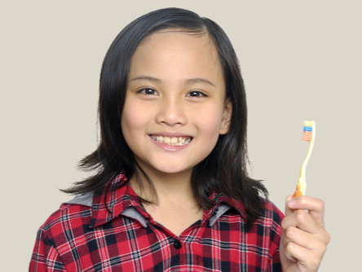
Part 3.0: Target Structures
Activity 3.1: Practice
Ask, “Who can I give … to? Whose is it/are they?”
car sandwich toothbrush bags bicycle wallet phone keys
Who can I give to? Whose is it?
Give it to . It’s .
Give it to . It’s .
Notes:
3.1 Whose Is It?
Allow one minute for this slide.
INSTRUCTIONS
Draw the Students’ attention to the text in the speech bubbles.
Ask Student A to fill in the blanks and read the question for Student B to answer.
ANSWER KEY
A: Who can I give the car to? Whose is it?
B: Give it to them. It’s theirs.
A: Who can I give the toothbrush to? Whose is it?
B: Give it to her. It’s hers.

Slide 22

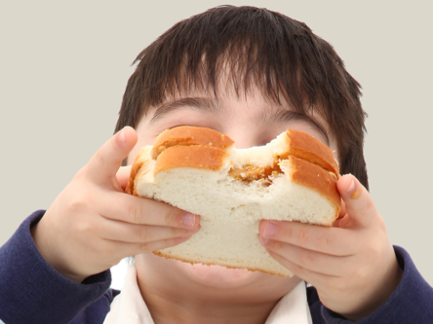
Part 3.0: Target Structures
Activity 3.1: Practice
Ask, “Who can I give … to? Whose is it/are they?”
car sandwich toothbrush bags bicycle wallet phone keys
Who can I give to? Whose is it?
Give it to . It’s .
Give them to . They’re .
Notes:
3.1 Whose Is It?
Allow one minute for this slide.
INSTRUCTIONS
Draw the Students’ attention to the text in the speech bubbles.
Ask Student B to fill in the blanks and read the question for Student A to answer.
ANSWER KEY
A: Who can I give the bags to? Whose are they?
B: Give them to her. They’re hers.
A: Who can I give the sandwich to? Whose is it?
B: Give it to him. It’s his.

Slide 23
Part 3.0: Target Structures
Activity 3.1: Practice
My children are sick so I have to take to the doctor.
We’re hungry! Bring something to eat.
That’s Marco’s phone. Give it back to .
Why are you giving it to me? It’s not .
I don’t understand this question. Can you tell the answer?
Is this pen ? Yes, it’s mine.
I want to tell Sofi. I’ll send a text message.
Notes:
3.1 Whose Is It?
Allow three minutes for this slide.
INSTRUCTIONS
Have the Students work together to fill in the blanks to complete the sentences.
ANSWER KEY
1. My children are sick so I have to take them to the doctor.
2. We’re hungry! Bring us something to eat.
3. That’s Marco’s phone. Give it back to him.
4. Why are you giving it to me? It’s not mine.
5. I don’t understand this question. Can you tell me the answer?
6. Is this pen yours? Yes, it’s mine.
7. I want to tell Sofi. I’ll send her a text message.
TEACHING TIP
If you have a stronger group, have the Students read the sentences again and change the people and pronouns. For example,
My daughter is sick so I have to take her to the doctor.

Slide 24
Part 3.0: Target Structures
Activity 3.1: Feedback
Student 1
Student 2
Student 3
Student 4
Great job!
Great job!
Great job!
Great job!
Well done
Well done
Well done
Well done
Good try
Good try
Good try
Good try
More practice
More practice
More practice
More practice
Feedback
Notes:
3.1 Whose Is It?
FEEDBACK
Quickly give the Students feedback on the target language they just practiced.
Remind them of other resources they can take advantage of to improve their English:
Go to Wall Street World to practice grammar and vocabulary.
Review the Student Manual or Digital Book to study grammar and vocabulary.
Attend Complementary Classes to practice using grammar and vocabulary.
Join Social Clubs to practice speaking skills.

Slide 25

Part 4.0: Communication
Activity 4.1: Context Creation
Yes, .
Is this yours?
it is
Do you want it?
Yes. Please give to .
it me
Notes:
4.1 Give It Back! (10 min)
Allow one minute for this slide.
OBJECTIVES
Can use object pronouns in simple phrases and sentences (Can you call her?)
Can use the possessive pronouns mine and yours with the verb be (They’re yours.)
INSTRUCTIONS
#1. Have a Student read the question. [Is this yours?]
#2. Encourage a Student to answer.
#3. Reveal the answer. [Yes, it is.]
#4. Have a Student read the question. [Do you want it?]
#5. Encourage a Student to read the text, filling in the blanks to complete the statement.
#6. Reveal the answer. [Yes. Please give it to me.]
TEACHING TIPS
Brainstorm/Elicit a variety of the target language, which will be used and assessed during the practice.
Elicit from each Student.
It helps to board elicited language.

Slide 26

Part 4.0: Communication
Activity 4.1: Context Creation
Whose car is this?
It’s .
theirs
Give it back to .
them
Notes:
4.1 Give It Back!
Allow one minute for this slide.
INSTRUCTIONS
#1. Have a Student read the question. [Whose car is this?]
#2. Have a Student read the text, filling in the blank to complete the statement.
#3. Reveal the answer. [It’s theirs.]
#4. Have a Student read the text, filling in the blank to complete the statement.
#5. Reveal the answer. [Give it back to them.]
TEACHING TIPS
Brainstorm/Elicit a variety of the target language, which will be used and assessed during the practice.
Elicit from each Student.
It helps to board elicited language.

Slide 27
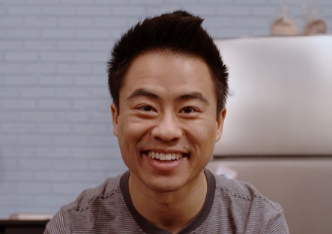
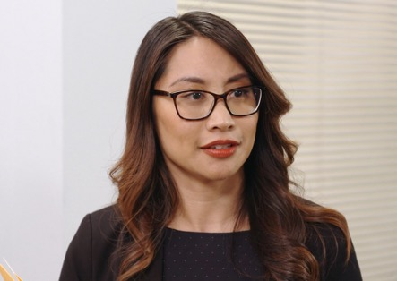
Part 4.0: Communication
Activity 4.1: Practice
Whose is the ? Who do I give it to?
pen
A bag
A laptop
A book
A sandwich
A television
A wallet
A pen
An umbrella
It’s . Give it to .
hers
her
Notes:
4.1 Give It Back!
Allow two minutes for this slide.
INSTRUCTIONS
Ask the Students to identify the people on screen. [Shen and Khae.] Say to the Students, “You will see four things Shen has, and four things Khae has. Try to remember who has what.”
#1. Have a Student read the list of Shen’s objects. [A television. A wallet. A pen. An umbrella.]
#2. Have a Student read the list of Khae’s objects. [A bag. A laptop. A book. A sandwich.]
#3. Reveal the questions and ask the Students the first question below. [Whose is the pen? Who do I give it to?]
#4. Encourage the Students to answer.
#5. Reveal the answers. [It’s hers. Give it to her.]
#6. Remove the previous answers and ask the Students questions for the wallet, sandwich, umbrella, bag, television, book, laptop. For example,
Teacher: Whose is the wallet? Who do I give it to?
Student: It’s his. Give it to him.
ANSWER KEY
(Wallet) It’s his. Give it to him.
(Sandwich) It’s hers. Give it to her.
(Umbrella) It’s his. Give it to him.
(Bag) It’s hers. Give it to her.
(Television) It’s his. Give it to him.
(Book) It’s hers. Give it to her.
(Laptop) It’s hers. Give it to her.

Slide 28



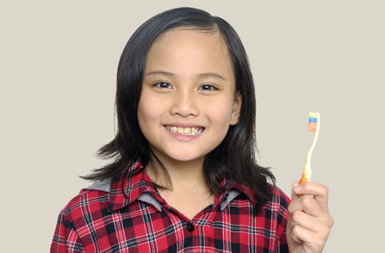
Part 4.0: Communication
Activity 4.1: Practice
1
2
3
4
Notes:
4.1 Give It Back!
Allow three minutes for this slide.
INSTRUCTIONS
Have the Students take turns asking and answering who the item belongs to. The Student answering will respond based on the photo, and will say who to give it back to. For example,
A: Whose pencils are these?
B: They’re his pencils. Give them back to him.
ANSWER KEY
1. Whose pencils are these?
They’re his. Give them back to him.
Whose car is this?
It’s theirs. Give it back to them.
Whose camera is this?
It’s his. Give it back to him.
Whose toothbrush is this?
It’s hers. Give it back to her.
TEACHING TIPS
Make sure the Students use full questions and answers.
If you have a weaker group, repeat the elicitation sequence in the Context Creation slides two or three times.

Slide 29
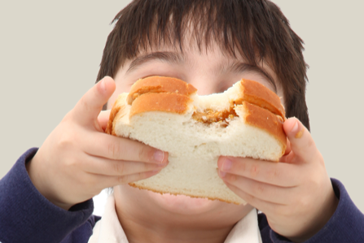
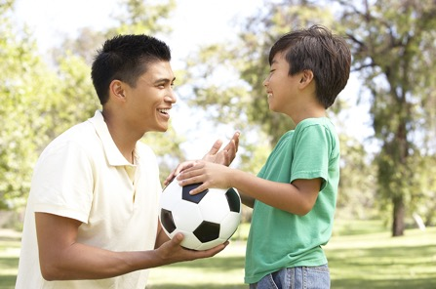

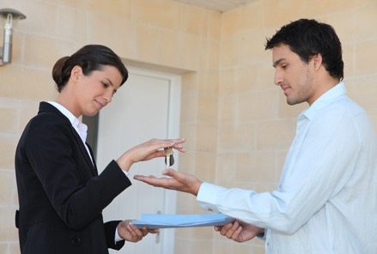
Part 4.0: Communication
Activity 4.1: Practice
5
6
7
8
Notes:
4.1 Give It Back!
Allow three minutes for this slide.
INSTRUCTIONS
Have the Students take turns asking and answering who the item belongs to. The Student answering will respond based on the photo, and will say who to give it back to. For example,
A: Whose sandwich is this?
B: It’s his sandwich. Give it back to him.
ANSWER KEY
5. Whose sandwich is this?
It’s his. Give it back to him.
6. Whose ball is this?
It’s theirs. Give it back to them.
7. Whose computer is this?
It’s hers. Give it back to her.
8. Whose keys are these?
They’re his. Give them back to him.
TEACHING TIPS
Make sure the Students use full questions and answers.
If you have a weaker group, repeat the elicitation sequence in the Context Creation slides two or three times.

Slide 30
Part 4.0: Communication
Activity 4.1: Feedback
 |  | Great job! | Well done | Good try | Need more practice
Student 1 | Range: How well you produce a range of language
 | Accuracy: How often you make mistakes
 | Quality of interaction: How well you ask and answer questions
 | Fluency and Spoken Production: How clearly you present ideas
Student 2 | Range: How well you produce a range of language
 | Accuracy: How often you make mistakes
 | Quality of interaction: How well you ask and answer questions
 | Fluency and Spoken Production: How clearly you present ideas
Student 3 | Range: How well you produce a range of language
 | Accuracy: How often you make mistakes
 | Quality of interaction: How well you ask and answer questions
 | Fluency and Spoken Production: How clearly you present ideas
Student 4 | Range: How well you produce a range of language
 | Accuracy: How often you make mistakes
 | Quality of interaction: How well you ask and answer questions
 | Fluency and Spoken Production: How clearly you present ideas
Notes:
4.1 Give It Back!
FEEDBACK
Quickly give the Students feedback on the target language they just practiced.
If you have a full class, focus on just a couple points each (i.e. their greatest strength and what they need to work on).
Remind them of other resources they can take advantage of to improve their English:
Go to Wall Street World to practice grammar and vocabulary.
Review the Student Manual or Digital Book to study grammar and vocabulary.
Attend Complementary Classes to practice using grammar and vocabulary.
Join Social Clubs to practice speaking skills.

Slide 31
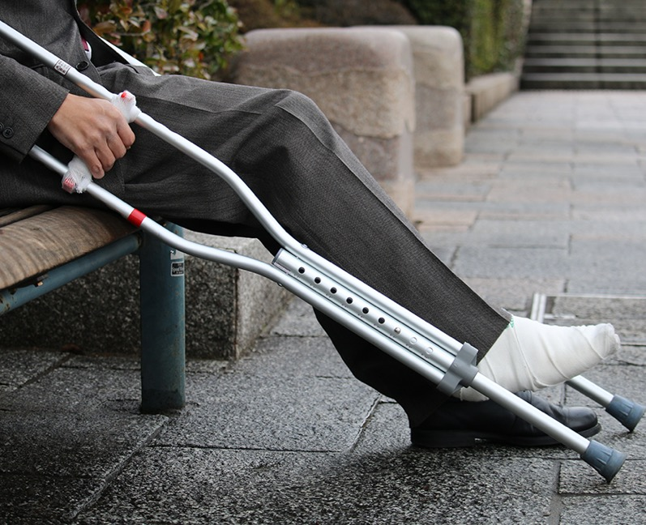
Part 4.0: Communication
Activity 4.2: Context Creation
What problem does he have?
What does he need to do?
.
His foot hurts
.
He needs to see a doctor
Notes:
4.2 At the Doctor’s (10 min)
Allow two minutes for this slide.
OBJECTIVES
Can name some very common ailments (flu; headache; hurt; ill)
Can name very basic parts of the body (back; head; leg; nose)
Can use brief everyday expressions to describe wants and needs, and request information (I don’t need an agent, but I want an agent.)
INSTRUCTIONS
#1. Have a Student read the question. [What problem does he have?]
#2. Encourage the Students to answer.
#3. Reveal the answer. [His foot hurts.]
#4. Have a Student read the question. [What does he need to do?]
#5. Encourage the Students to offer suggestions.
#6. Reveal the possible answer. [He needs to see a doctor.]
TEACHING TIPS
Brainstorm/Elicit a variety of the target language, which will be used and assessed during the practice.
Elicit from each Student.
It helps to board elicited language.

Slide 32
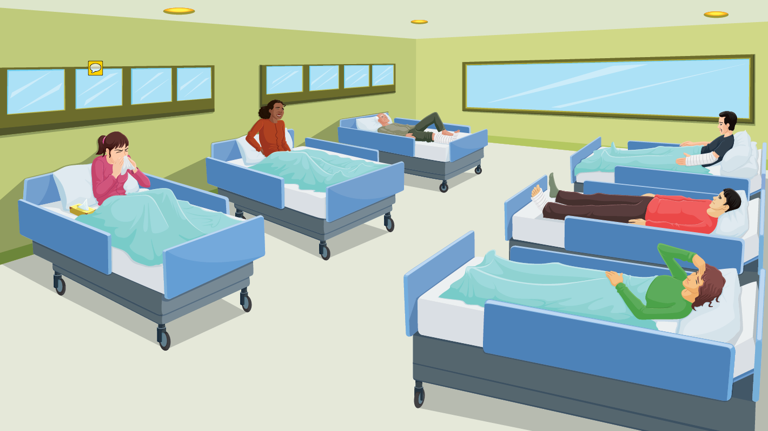
Part 4.0: Communication
Activity 4.2: Practice
What is wrong with these people?
Notes:
4.2 At the Doctor’s
Allow four minutes for this slide.
INSTRUCTIONS
Draw the Students’ attention to the image and to the question at the top of the screen and have one of them read it. [What is wrong with these people?]
The Students must take turns making sentences to describe what is wrong with each patient, for example,
A: She has a cold.
B: His leg hurts.
A: She has a headache
…
Allow time for the Students to talk, then ask, “What do they need to do?”
Elicit suggestions, for example,
She needs to eat some chicken soup.
He needs to stay in bed/lay down.

Slide 33

Part 4.0: Communication
Activity 4.2: Practice
Students A and B
Patient: Hello, doctor.
Doctor: Hello. What’s wrong?
Patient: .
Doctor: You need to .
Patient: OK, thank you, doctor.
Notes:
4.2 At the Doctor’s
Allow two minutes for this slide.
INSTRUCTIONS
Put the Students into A/B and C/D pairs.
Have the A/B pair of Students complete the dialog using their own ideas. Assign Student A to be a doctor, and Student B to be a patient. For example,
A: Hello, doctor.
B: Hello. What’s wrong?
A: My head hurts.
B: You need to lie down/take something.
A: OK, thank you, doctor.
Have the Students role-play the dialog, then change roles and repeat.
TEACHING TIP
Encourage the Students to use a variety of language in their dialogs.

Slide 34

Part 4.0: Communication
Activity 4.2: Practice
Students C and D
Patient: Hello, doctor.
Doctor: Hello. What’s wrong?
Patient: .
Doctor: You need to .
Patient: OK, thank you, doctor.
Notes:
4.2 At the Doctor’s
Allow two minutes for this slide.
INSTRUCTIONS
Have C/D pair of Students complete the dialog using their own ideas. Assign Student C to be a doctor, and Student D to be a patient. For example,
C: Hello, doctor.
D: Hello. What’s wrong?
C: My leg hurts.
D: You need to rest your legs.
C: OK, thank you, doctor.
Have the Students role-play the dialog, then change roles and repeat.

Slide 35
Part 4.0: Communication
Activity 4.2: Feedback
 |  | Great job! | Well done | Good try | Need more practice
Student 1 | Range: How well you produce a range of language
 | Accuracy: How often you make mistakes
 | Quality of interaction: How well you ask and answer questions
 | Fluency and Spoken Production: How clearly you present ideas
Student 2 | Range: How well you produce a range of language
 | Accuracy: How often you make mistakes
 | Quality of interaction: How well you ask and answer questions
 | Fluency and Spoken Production: How clearly you present ideas
Student 3 | Range: How well you produce a range of language
 | Accuracy: How often you make mistakes
 | Quality of interaction: How well you ask and answer questions
 | Fluency and Spoken Production: How clearly you present ideas
Student 4 | Range: How well you produce a range of language
 | Accuracy: How often you make mistakes
 | Quality of interaction: How well you ask and answer questions
 | Fluency and Spoken Production: How clearly you present ideas
Notes:
4.2 At the Doctor’s
FEEDBACK
Quickly give the Students feedback on the target language they just practiced.
If you have a full class, focus on just a couple points each (i.e. their greatest strength and what they need to work on).
Remind them of other resources they can take advantage of to improve their English:
Go to Wall Street World to practice grammar and vocabulary.
Review the Student Manual or Digital Book to study grammar and vocabulary.
Attend Complementary Classes to practice using grammar and vocabulary.
Join Social Clubs to practice speaking skills.

Slide 36
Encounter 16
Overall Feedback
 |  | Great job! | Well done | Good try | Need more practice
 | Activity 2.1: Body Parts
 | Activity 2.2: I Feel Sick
 | Activity 3.1: Whose Is It?
 | Activity 4.1: Give It Back!
 | Activity 4.2: At the Doctor’s
Student 1
Feedback
Notes:
OVERALL FEEDBACK (3–5 min)
Allow one minute for this slide.
Explain to the Students that you will now be giving them an overall assessment and recommendations. Use the following prompts to help you explain the assessment:
First, you did a really good job of…
The areas where you could use a little more practice are…
The language points I didn’t hear you use were...
As a result, I’d recommend that you… [continue on to Unit 17… work on (X, Y, Z ) and repeat Encounter 16].
Do you have any questions?

Slide 37
Encounter 16
Overall Feedback
 |  | Great job! | Well done | Good try | Need more practice
 | Activity 2.1: Body Parts
 | Activity 2.2: I Feel Sick
 | Activity 3.1: Whose Is It?
 | Activity 4.1: Give It Back!
 | Activity 4.2: At the Doctor’s
Student 2
Feedback
Notes:
OVERALL FEEDBACK (3–5 min)
Allow one minute for this slide.
Explain to the Students that you will now be giving them an overall assessment and recommendations. Use the following prompts to help you explain the assessment:
First, you did a really good job of…
The areas where you could use a little more practice are…
The language points I didn’t hear you use were...
As a result, I’d recommend that you… [continue on to Unit 17… work on (X, Y, Z ) and repeat Encounter 16].
Do you have any questions?

Slide 38
Encounter 16
Overall Feedback
 |  | Great job! | Well done | Good try | Need more practice
 | Activity 2.1: Body Parts
 | Activity 2.2: I Feel Sick
 | Activity 3.1: Whose Is It?
 | Activity 4.1: Give It Back!
 | Activity 4.2: At the Doctor’s
Student 3
Feedback
Notes:
OVERALL FEEDBACK (3–5 min)
Allow one minute for this slide.
Explain to the Students that you will now be giving them an overall assessment and recommendations. Use the following prompts to help you explain the assessment:
First, you did a really good job of…
The areas where you could use a little more practice are…
The language points I didn’t hear you use were...
As a result, I’d recommend that you… [continue on to Unit 17… work on (X, Y, Z ) and repeat Encounter 16].
Do you have any questions?

Slide 39
Encounter 16
Overall Feedback
 |  | Great job! | Well done | Good try | Need more practice
 | Activity 2.1: Body Parts
 | Activity 2.2: I Feel Sick
 | Activity 3.1: Whose Is It?
 | Activity 4.1: Give It Back!
 | Activity 4.2: At the Doctor’s
Student 4
Feedback
Notes:
OVERALL FEEDBACK (3–5 min)
Allow one minute for this slide.
Explain to the Students that you will now be giving them an overall assessment and recommendations. Use the following prompts to help you explain the assessment:
First, you did a really good job of…
The areas where you could use a little more practice are…
The language points I didn’t hear you use were...
As a result, I’d recommend that you… [continue on to Unit 17… work on (X, Y, Z ) and repeat Encounter 16].
Do you have any questions?

Slide 40

Part 5.0: Wrap-Up
A
hair
E
legs
B
feel sick
F
have the flu
C
headache
G
eyes
D
arm
H
have a cold
Notes:
5.1 Guess the Problem (10 min)
Allow ten minutes for this slide.
INSTRUCTIONS
Have the Students take turns describing/explaining one of the words/phrases they see, without saying the word(s). The other Students compete to see who can be first to say the right word/phrase.

Slide 41

Thank you for coming.
We hope you enjoyed the class.
Don’t forget
to leave feedback!
Teacher
Class was fun
Instructions were clear
«««««
«««««
«««««
«««««
«««««
«««««

Slide 42
© 2017 by Pearson Education Limited All rights reserved.
No part of this publication may be reproduced, stored in a retrieval system, or transmitted in any form or by any means, electronic, mechanical, photocopying, recording or otherwise without the permission of the Publishers.
This material is the intellectual property of Pearson Education Limited.
Image Credits:
Lel Soleil/Fotolia; Phattman/Fotolia; oticki/Fotolia; tiero/Fotolia; aerogondo/Fotolia; alphaspirit/Fotolia; grimaldello/Fotolia; gstockstudio/Fotolia; ramonespelt/Fotolia; oneinchpunch/ Fotolia; Igor Mojzes/Fotolia; SkyLine/Fotolia; paul prescott/Fotolia; viperagp/Fotolia; jillchen/ Fotolia; ambrozinio/Fotolia; Monkey Business/Fotolia; Monkey Business/Fotolia; michaeljung/Fotolia; DragonImages/Fotolia; burachet/Fotolia; ake1150/Fotolia; michaeljung/Fotolia; michaeljung/Fotolia; WavebreakMediaMicro/Fotolia; letuve/Fotolia; sepy/Fotolia

